Slide 1



IST-687 Group A
Dennis, Kéli, Darius, Quintin

Slide 2
Agenda
Business Objective
Data Summary and Munging
Analytical Approach
Consumer Demographics Analysis
Consumer Behavior Analysis
Conclusion

Slide 3
Business Objective
The objective of the project is to provide analysis of customer demographics and behavior.
The analysis will provide data driven insights which can be used to improve business inventory management, marketing strategies, and sales growth by answering the following questions:
Who is our target demographic?
Which products are generating the most sales revenue?
What states are generating the most sales by products and revenue?
Are sales impacted by seasonality?
Does method of payment or frequency of purchase show any usable trends?

Slide 4
Data Summary and Munging
Dataset contains customer transaction data
Sample of 3,900 customers
Attributes such as gender, age, payment method, item purchased, etc.
The following functions were performed to clean the data:
Removed NAs
Removed special characters from column names
Removed spaces from column names
Filtered data
Sorted data

Slide 5
Consumer Demographic Analysis
Analysis of Customer Base
Notes:
- For the first part of our analysis, we looked at the demographics of the customers contained in the dataset.

Slide 6
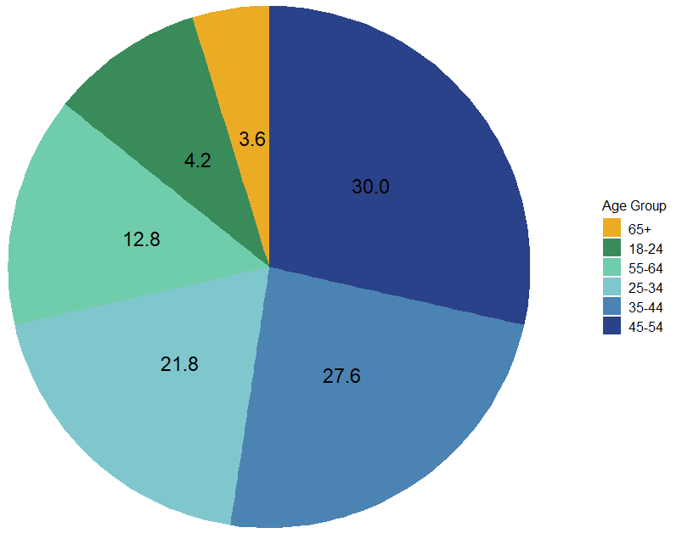
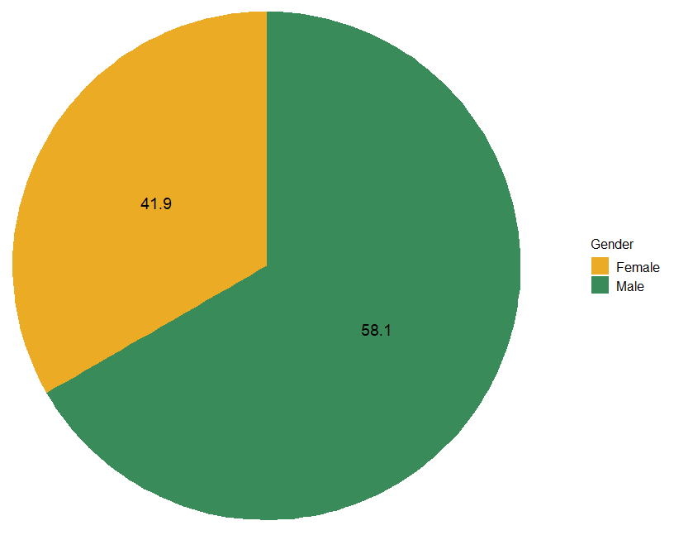
Consumer Demographic Analysis
Age Analysis
Gender Analysis
+ Largest age group is 45 to 54 + Average customer age is 43 years old.
+ 58% of customer are male
+ 42% of customers are female
Notes:
- We found the largest age group is 45 to 54 years old at 30%. Customers in the age range of 35-44 years old are a close second at about 28%.
- The two smallest groups are customers 65 and older at 3.6 and customers 18-24 years old at 4.2%
-The average customer is 43 years old. The maximum age is 70 years old and the minimum age is 18.
-We also found 58% of customers are men and 42% of customers are female.

Slide 7
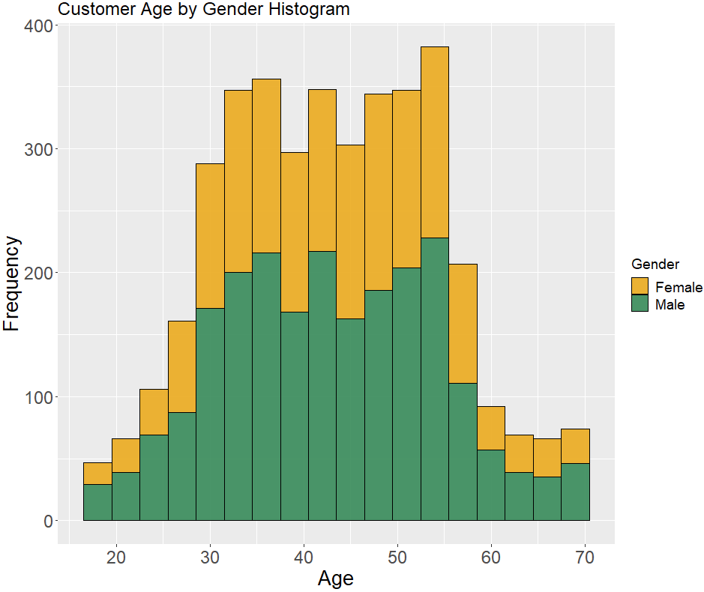
Consumer Demographic Analysis
+ The distribution of male and female is similar across each age group.
+ The largest age group of either gender ranges between 35 and 54 years old.
Notes:
-This graph shows customer gender distribution across age groups.
- As you can see, the age breakdown is very similar for both genders.
- The largest age group is 35-54 years old for both men and women.

Slide 8
Consumer Behavior Analysis
Purchases by Season
Most Common Item Purchased
Dollars Spent per State
Customer Purchase Frequency

Slide 9
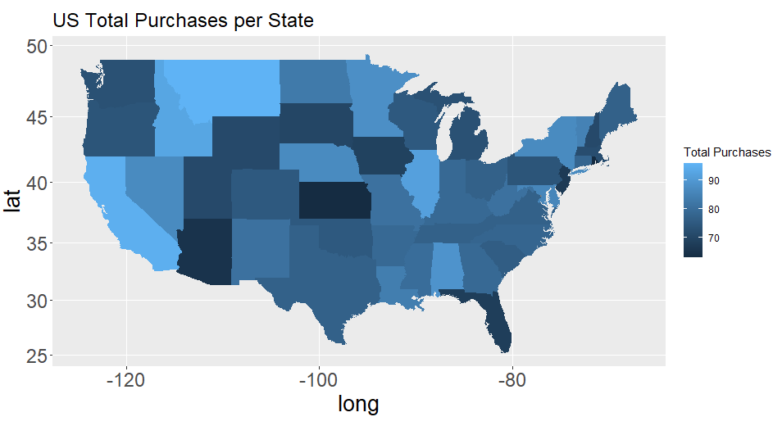
Consumer Behavior Analysis
Greatest number of purchases
+ Montana
+ California
+ Illinois
Least number of purchases
+ Rhode Island
+ Kansas
+ Arizona

Slide 10
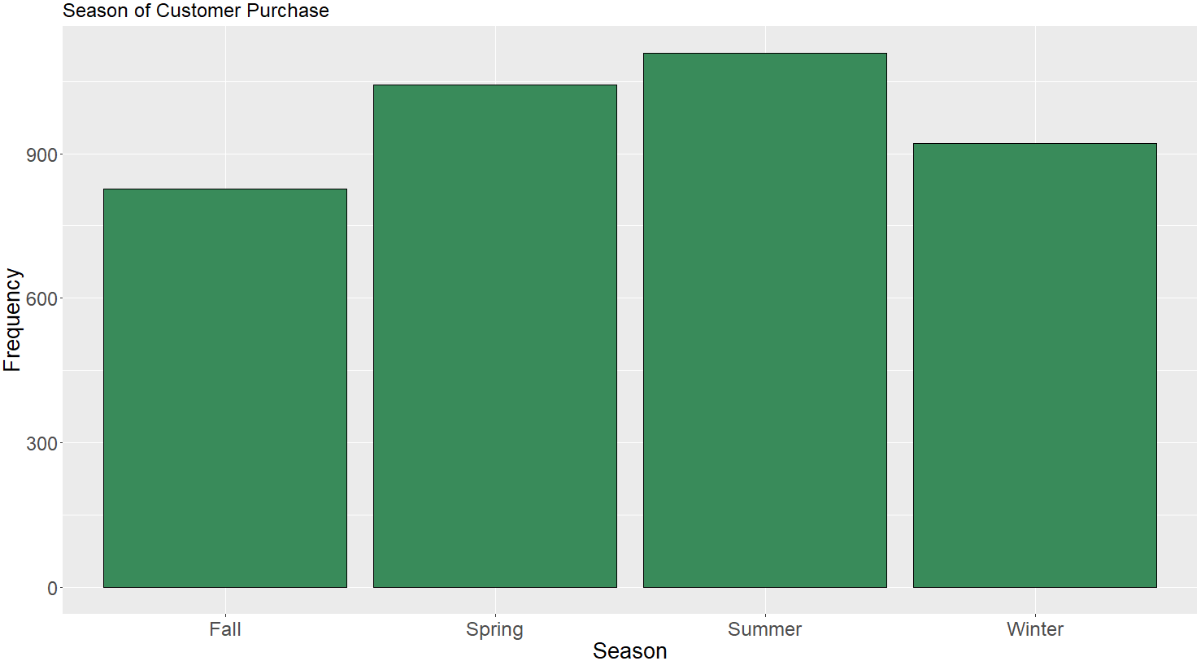
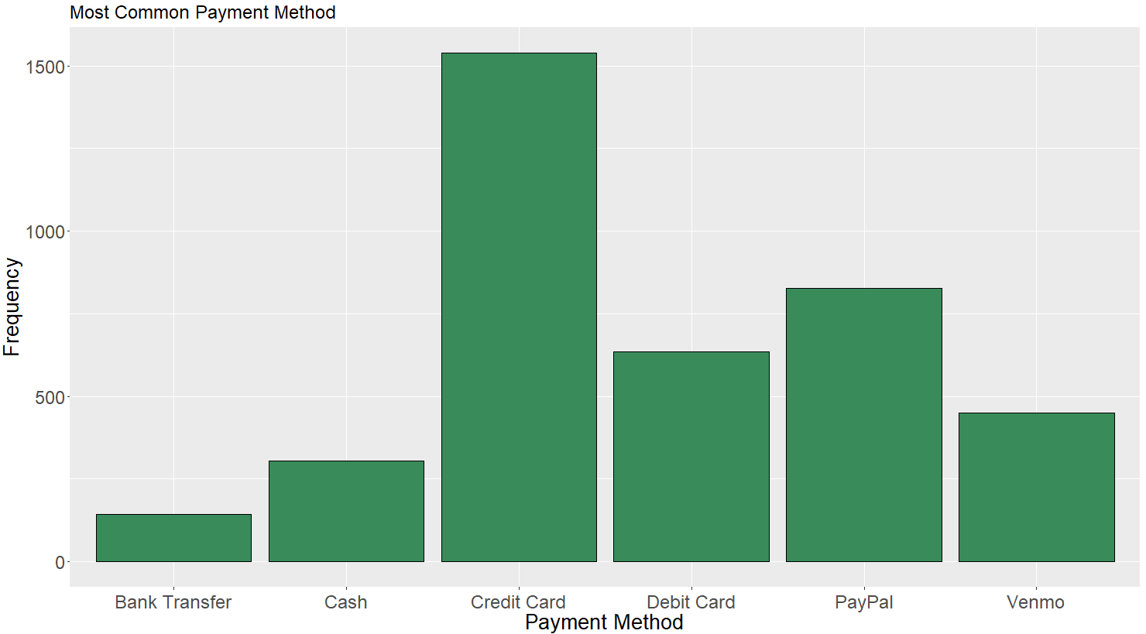
Consumer Behavior Analysis
+ Purchases made each season are mostly evenly distributed
+ Credit cards are used most to purchase items
+ Third party app purchases are also popular

Slide 11
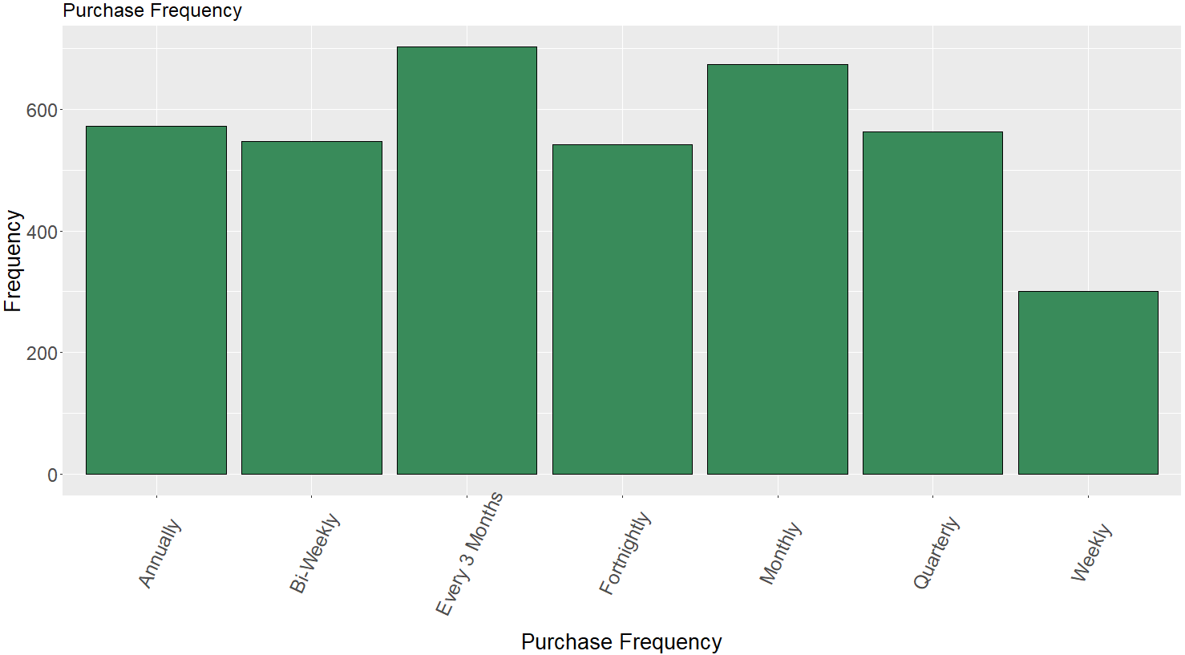
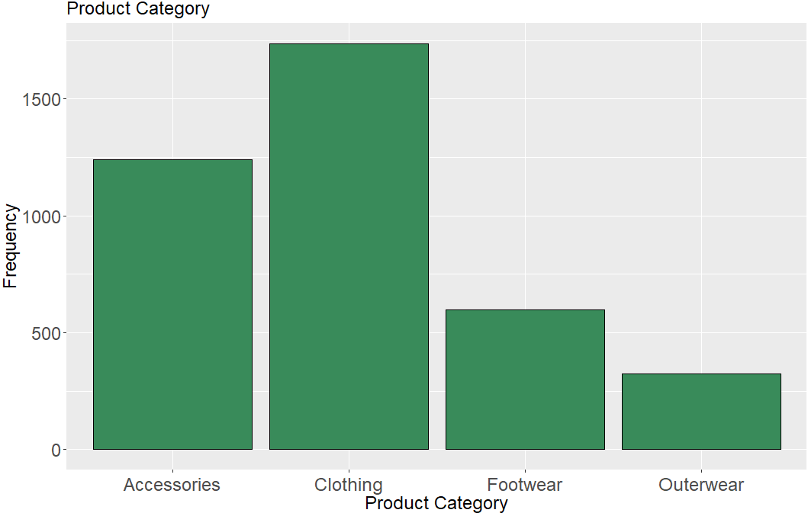
Consumer Behavior Analysis
+ The most common purchase frequency is monthly and every 3 months.
+ The most common item purchased is clothing.
+ The least common item purchased is outerwear.

Slide 12
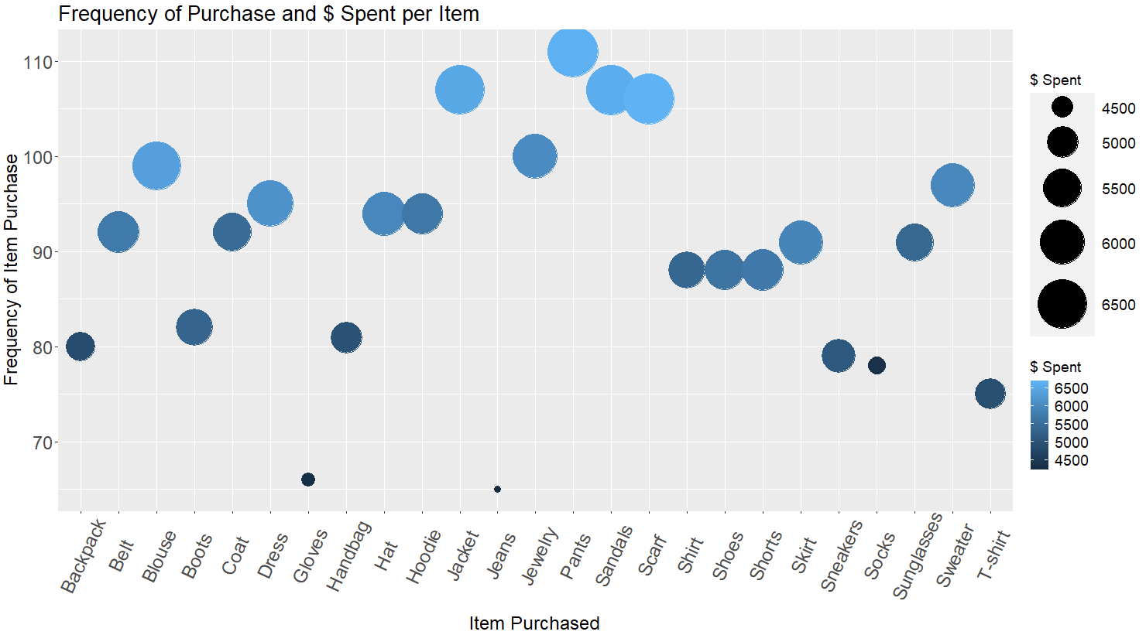
Consumer Behavior Analysis
Customers 35-54 years old make about 60% of total purchases.
Most frequently purchased items:
+ Pants
+ Sandals
+ Jackets
+ Scarfs
+ Jewelry

Slide 13
Conclusion
Company Capitalization
+ Inventory Focus
+ Underperforming Product Refresh
+ Regional and Marking Strategy

